Slide 1
Promoting innovation in Earth Observation-based services
balticsatapps.eu

Slide 2
Towards new innovations
The BalticSatApps project has conducted innovation generation activities that have aimed at the creation of new EO-leveraging services and startup companies. These activities have taken place in the form of innovation competitions and hackathons. The innovation promotion activities in BalticSatApps were conducted in collaboration between experts in various areas of expertise: EO user uptake and EO data use, education facilities, and science and technology parks.

Slide 3
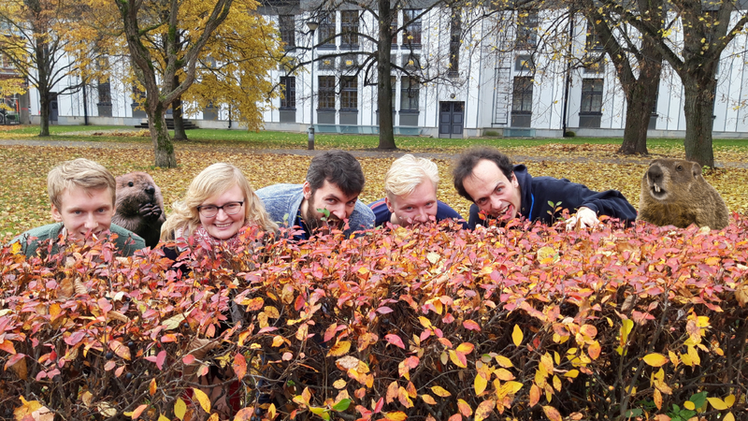
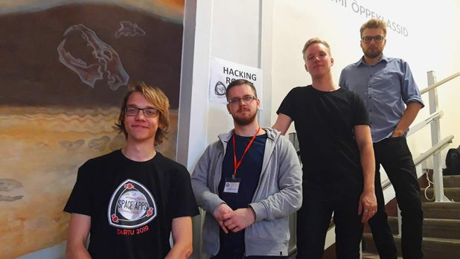
Tartu Space Apps Challenge (Oct. 2019)
WINNER:
SpaceBeavers
Flood monitoring and prevention software
1st RUNNER-UP:
Cloudless
Neural network-based algorithm to make both reading and interpreting satellite data more accurate and comprehensive
2nd RUNNER-UP:
DLC
App providing a historical overview of land cover changes, utilizing the Landsat and Sentinel databases
Notes:
Space Apps Challenge (Tartu, Estonia)
5o participants
8 teams
Tech and business mentors
3 days + 2 nights (18-20.10.2019)

Slide 4
WeSeaChallenge
Idea competition where satellite
data-based solution ideas for
marine protection and planning were sought.
Running 1.10. - 4.12.2019
10 teams
30 participants
3 challenge categories
Sustainable aquaculture
Urban planning
Networked actions
Prize pool 8500€
Training and mentoring was made available during whole competition
Awards ceremony took place on 4th December, 2019, in Turku
Notes:
Text slide

Slide 5
Teams Baltic Connect and Tech Trout took home in total 6500 euros for their winning solutions in WeSeaChallenge!
Notes:
3 challenge categories
Sustainable aquaculture
Urban planning
Networked actions

Slide 6
Key findings…
As one of the central findings of the project, it was noticed that due to the complexity of the thematic area of EO, it was often most fruitful to conduct longer-time spanning innovation activities, instead of short-term activities. During longer-term activities, the participants were given lectures, hands-on support, and more time overall to develop their solution ideas, when compared with more traditional hackathon activities.

Slide 7
Result focus: The ”Cookbook” of how to arrange innovation generation events and iterative development in EO
The Cookbook provides an extensive description about
how short-term events can be operated in order to identify ideas that exploit remote sensing and earth observation,
enrich the ideas, and
transform them into sustainable business solutions.
The publication is a “cookbook” by the way of exhaustively describing what are the different stakeholder groups, their responsibilities and connections to short-term events. And what pre- and post-operations need to be committed in order to ensure that the short-term events truly develop a solution to a need in a sustainable manner.
Notes:
The work conducted in EO innovation promotion has been documented in the form of a guide on how to arrange innovation generation events and iterative development in EO. You can find the guide at balticsatapps.eu.

Slide 8
Result focus: The ”Cookbook” of how to arrange innovation generation events and iterative development in EO
Who can benefit from the ”Cookbook”?
Challenge owners: farmers, herders, fisheries, forestries, and NGOs representing them
Solution builders: skilled individuals, startup accelerators, entrepreneurs, researchers, etc
Business enablers: funding instruments, venture capital, incubators, business festivals
The key message
To challenge owners: importance of communicating value added if challenge solved
Solution builders: truly understanding challenge owners context and responsibilities to business enablers
Business enablers: peculiarities of the EO context: slow moving, grainy satellites and notable public-funded data analysis pipelines involved

